Slide 1


Air Traffic scaling, delay- analysis and prediction using pyspark on Hadoop Cluster
Mohammed Zoher Guniem
Megh Raj Upreti
NAME, title
DAT500 Date intensive systems, group 23
Notes:
Mohammed and megh

Slide 2
- There exist a huge need to provide realistic data for air traffic analyzation and simulation. Scaling big datasets in an efficient way is essential for these modern air traffic application. - Scaling our flights from dataset with respect to UTC time interval and some limited but adjustable geographical area. - Scaled data is served to the user or client application on demand by providing a time interval and the geographic coordinates of the Lower Left Corner, LLC and Upper Right Corner, URC.
Scaling and simulation, USE CASE - I
Notes:
Mohammed

Slide 3
- An arrangement of some basic statistics of the 5 different delays into categories extracted from other target columns like origin and destination etc… - The output is used to feed a Power BI model which helps the user to easily view and analyze the distribution of delays over any target category. - Categories can also be combined of one or more csv columns, like route between states, cities or airports. - This improves the speed of the power BI model and the overall experience of the user, because our Pyspark script can be configured with more than one category as a target using a json config file.
Delay Analysis, USE CASE - II
Notes:
Mohammed

Slide 4
- Prepared data is checked for numeric and categorical variables. - All categorical variables are converted into binary vectors by using transformation called ‘Onehotencoderestimator’. - Numeric variables and binary vectors are combined and transformed into single list of vectors by using a vector assembler. - Pipelines are introduced to keep required vectors and model is trained and tested through this pipeline.
Delay prediction, USE CASE III
Notes:
Megh

Slide 5

Related Work
Scaling and simulation
Grether et.al performed simulation and scaling that looks all the data variables. The flight details are taken from OAG data and for each airline transit line is generated, all local times converted into UTC time, which ensures take off and landing time to be consistent for analysis. (Agent-based Modelling and Simulation of Air Transport Technology, 2013)
Delay analysis
In a paper published by Jun chen and Meng Li, performed several data analysis like departure delay, arrival delay for each aircraft, normalize and scaled the data, counted delayed and non delayed flights, analyze departure and arrival delays with flight date, airport, aircraft. (Chained Predictions of Flight Delay Using Machine Learning, 2019)
Delay prediction
Report published by Neil and Samir in Predicting Flight delays used many machine learning algorithms like Random Forest, Linear regression, gradient boosted trees and found out gradient boosted trees outperformed others with the AUC 0.81 and correctly classified Confusion matrix. (Movva and Menon, n.d.)
Notes:
Megh

Slide 6
- Main dataset Open Source CSV files from the US Bureau of Transportation Statistics which includes all of the domestic flights in the USA from 2019. Size can vary according to need, In our case about 1.88 GB to start with. - Support dataset In order to include airport’s latitude and longitude in addition to time zone information, We use a support dataset from the same source which is about 1,17 MB in size.
Dataset(s)
Notes:
Megh

Slide 7
Dataset(s), strengths and weaknesses
Strengths
Provides detailed information about the flight route from taxing into the runway until final arrival at the terminal.
Reasons for flight delays are given in 5 clear and reasonable categories.
Support dataset is available to assist special need like difference between local time and UTC time.
Weaknesses
Clock time like wheels off and wheels on is given in local time, which makes it essential to convert these into UTC times.
Delay categories are numeric and needs to be converted into suitable interval categories for prediction.
No airport coordinates included in the main dataset.
Notes:
Mohammed

Slide 8
Scaling and simulation, Implementation and challenges
Preparing the data
Unclean data
No wheels off, wheels on, or airtime. Due to cancelation or other unknow reason.
No coordinates of origin and destination airports, and time is given in local clock
We had to use support data from the same provider to get geographic coordinates and convert local time to UTC time.
Scaling
Wheels off and/or wheels on before/after target time interval
Solved by processing data from yesterday, today and tomorrow.
Calculating the flight position at each minute
Relayed on Great circle calculations using python basemap library.
by using the given airtime value to get position at each minute with average speed.
Simulation
Designing an example of a client application with pure python
By using JSON data provided by scaling step above on a daily basis,
we can run simulations in between requested time interval and geographic area in an efficient and fast approach.
Notes:
Mohammed

Slide 9
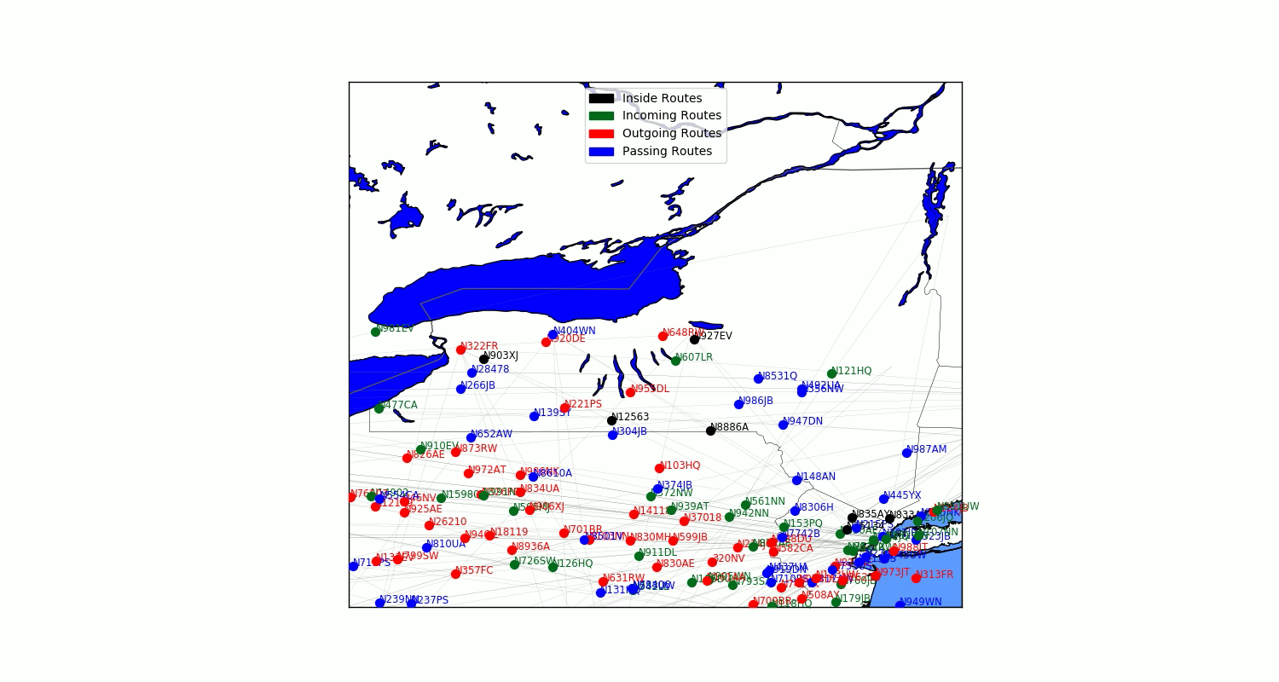
Simulation over New York State, between 18:00 and 18:30 at 10.04.2019
Notes:
Mohammed

Slide 10

Delay Analysis, Implementation and challenges
Power BI Visualization
PySpark improves the performance of Power BI
Although Power BI is capable of performing all basic statistics calculations, loading a dataset of a very big size to power BI will harm the speed and user experience of its useful visualization tools.
Grouping delays and its statistics
Identifying the 5 different delays as target
Weather delay, NAS delay, Security delay, Carrier Delay and Late aircraft delay, the sum of all delays is also included in case more than one delay is caused on the same flight.
It is interesting to know sum, average, minimum and maximum of all 5 delays
Mode and median are often equals 0 because most flights has no delay. Minimum is also often equals to 0 but we calculated it anyway since it’s crucial to know in case some feature category is experiencing a certain delay as minimum.
Calculating the statistics
User provides feature columns like origin and/or destination in single or grouped matter,
The delay statistics are then grouped and calculated according to the provided feature column(s).
User Input and Output to Power BI
User Input
User uses a JSON config file to configure one or more calculation with as many feature columns as wanted.
Output
The PySpark script outputs its result calculation in a csv format file, and this file can be used to feed the Power BI model.
Notes:
Mohammed

Slide 11
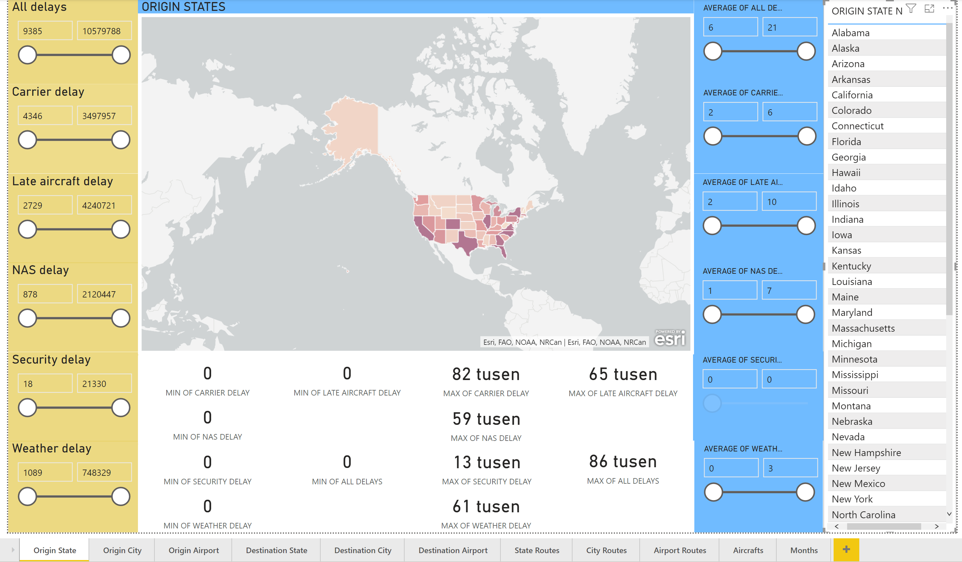
Power BI Model
Notes:
Mohammed

Slide 12
- Used Spark SQL and dataframes to filter the data, and explore the required information - Spark Mllib for predicting delays Spark Mllib is computationally faster than MR, efficient and run in many domains - Pyspark provides good speed due to in-memory computation. It also has open-source machine learning algorithms, but spark is written in Scala, so python API is slow. -The model is prone to overfitting, data leakage and unstable for prediction in decision tree, challenges in Hyperparameter tuning resulting cluster too slow for execution.
Delay Prediction, Implementation and challenges
Notes:
Megh

Slide 13
Summary
Scaling and simulation
Preparing the data:
One run on Hadoop cluster, increases the size of dataset to 2,5 GB. Takes about 15 minutes to finish.
Scaling:
One run every day on Hadoop cluster to scale data for the day after.
Outputs 2 json files with size of 200 MB in total,
The first file is for route information and the second is for position of each route at each minute in unix time.
Simulation:
Runs by user on client-side.
Generates a .gif picture and .avi video.
Shows the different type of aircrafts and movement of air traffic across the requested area in the requested time limits.
Delay Analysis
Script design and execution:
Runs when requested by user on Hadoop cluster, who uses a json file to configure the script. Takes about 15 minutes to run,
Takes about 5-10 minutes to finish 10 singles and 1 merged configurable analysis.
Input and output:
The entire dataset without any support data is loaded into memory at start, output a file of nearly 5 MB for the analysis mentioned above.
The output csv files are then loaded into Power BI for visualization.
Notes:
Mohammed

Slide 14
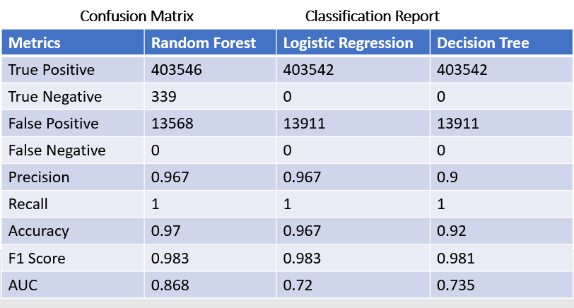
Summary Continued….
Delay Prediction
Preparing data:
Categorical data is converted into onehotencoderestimator
numerical and categorical data converted into vector assembler
Modelling:
Build the model in Training data
Predict the models in testing data
Model Evaluation:
Notes:
Megh

Slide 15
References:
Movva, N. and Menon, S., n.d. Predicting Flight Delays And Cancellations Using Weather As A Feature. [online] Available at: <http://cs229.stanford.edu/proj2016/report/MenonMovva-PredictingFlightDelays-report.pdf> [Accessed 12 April 2020].
2013. Agent-Based Modelling And Simulation Of Air Transport Technology. [online] Available at: <https://www.sciencedirect.com/science/article/pii/S1877050913007175> [Accessed 12 April 2020].
Researchgate. 2019. Chained Predictions Of Flight Delay Using Machine Learning. [online] Available at: <https://www.researchgate.net/publication/330185077_Chained_Predictions_of_Flight_Delay_Using_Machine_Learning> [Accessed 12 April 2020].
Notes:
Megh

Slide 16


Thanks
Project code, documentation, Power BI model and examples will soon be available in report and on Github repository.
Notes:
Megh

